Slide 2
Agenda
Introduction with Cara S. Forster (SPTF)
Presentation from Core Woman
Question and Answer
Presentation from Friendship Bridge
Question and Answer
Panelists:
Susana Martinez-Restrepo, PhD, Core Woman (United States / Colombia)
Caitlin Scott, Friendship Bridge (United States)
Victor Contreras, Friendship Bridge (Guatemala)

Slide 3
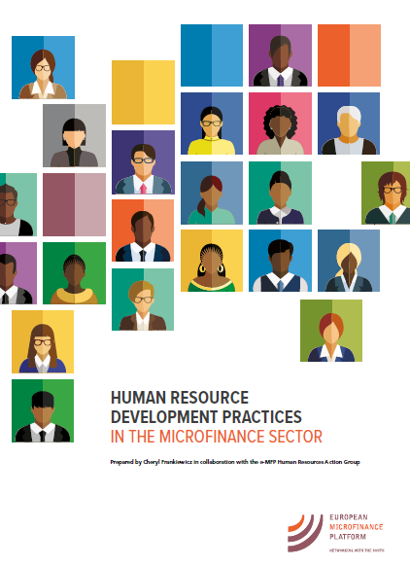

Slide 4
Q&A
Notes:
Poll 4: Which aspects of capacity building towards supporting managers in their HR functions would you be interested in for your organization (multiple answers possible)?
-None
-Capacity building for HR department on developing internal capacity to support managers
-Capacity building for managers on strategic HR functions
-Capacity building for managers on administrative HR functions

Slide 5
Additional Resources
European Microfinance Platform HR action group
Publication: HRD practices in the microfinance sector
Universal Standards for Social and Environmental Performance: https://cerise-sptf.org/download-the-manual/
Notes:
HR AG started work on 2018 => aim to promote HRD as an integral part of good business practices in MFIs => convinced that this is a critical success factor for financial institutions to remain competitive and deliver on their (social) objectives.
Lack of recent global data on HR management practices => launched large-scale global survey to map out the landscape of HR management practices and to shed some light into the relationship between those and MFI performance (data of 195 MFI across 56 countries used to draw landscape)
Concept underlying the analysis was the journey of an employee in any organization => talent management life cycle starting even before recruitment, over onboarding, performance management… development… succession planning… exit => INTERESTING RESULT: reliance on supervisors

Slide 6
Thank you for joining us today!

